Slide 1
Attenuation
Dispersion

Slide 2
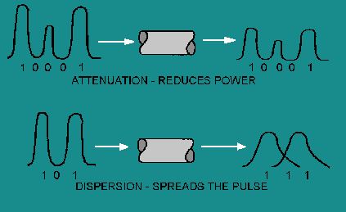
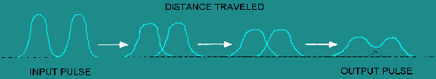
PROPERTIES OF OPTICAL FIBER TRANSMISSION
Lecture 3

Slide 3
Attenuation or Power loss in Optical fibers
The power of the light at the output end is found to be always less than the power launched at the input end.
Attenuation is found to be a function of fiber material, wavelength of light and length of the fiber and it is measured in terms of the decibel.

Slide 4
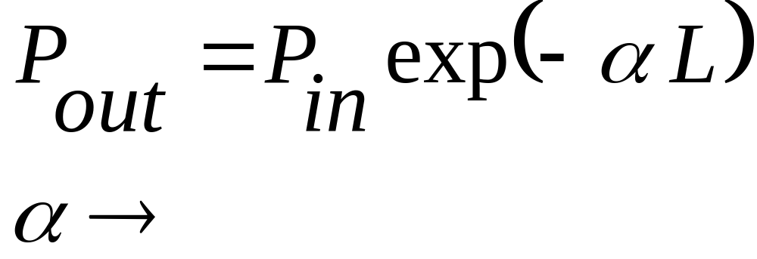
Fiber Attenuation
If P_{in} power is launched into the fiber, the power remaining after propagating a length L within the fiber P_{out} is
Linear Attenuation Coefficient

Slide 5
Attenuation
Attenuation types….
Intrinsic Extrinsic
1.Scattering losses 1.Absorption losses
2.Absorption losses 2.Bending losses
(a) Macro-bending
(b) Micro-bending

Slide 6
Material Absorption
Intrinsic: Caused by atomic resonance of the fiber material.
Extrinsic: Caused by atomic absorptions of external particles in the fiber.

Slide 7
Scattering Loss
There are many kinds of scattering loss
  Rayleigh scattering
  Mie scattering
Many other scattering losses are there which depend on the power inside the optical fiber
  Insignificant unless the power is greater than 100mW

Slide 8
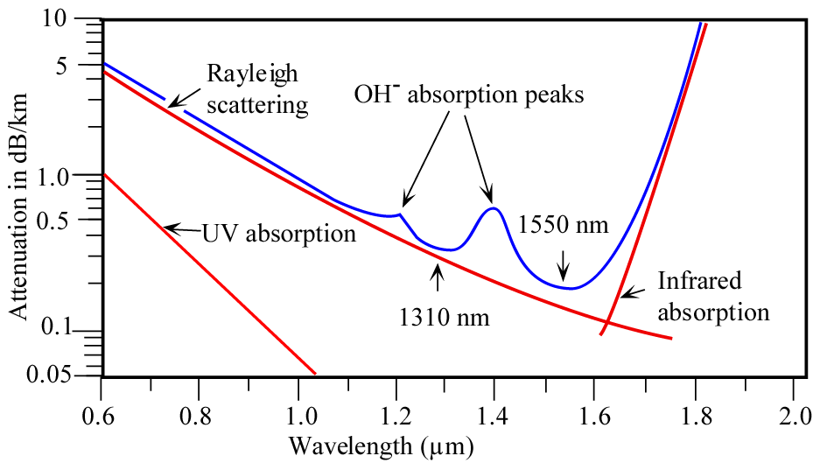
Absorption and Scattering Loss

Slide 9
External Losses
  Radiation loss at bends in the optical fiber
  Macro-bending
  Micro-bending
  Misalignment of core centers
  Air gaps
  End face reflections

Slide 10
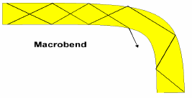

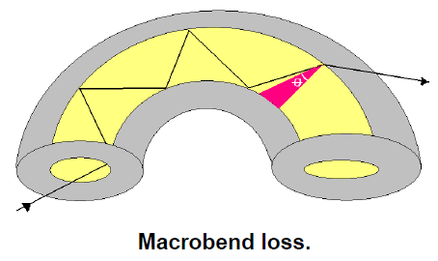
Bending Loss
Micro-bending is commonly caused by poor cable design and poor installation and handling.
Light Leak out of the fiber when the fiber is bend.

Slide 11
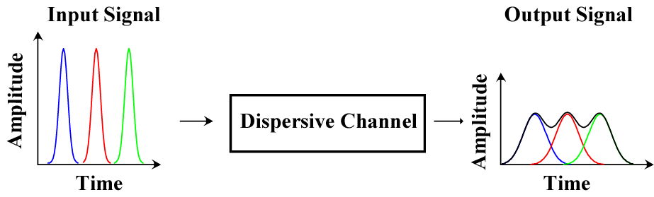
Dispersion
Dispersive medium: velocity of propagation depends on frequency
Dispersion causes temporal pulse spreading
Dispersion is related to the velocity of the pulse

Slide 12
Cause of Fiber Dispersion
Types of Dispersion
Multimode
Dispersion
Material
Dispersion
Waveguide
Dispersion
Multimode group delay dispersion is the variation in group velocity among the propagation modes at a single frequency
Material Dispersion is due to variation in the refractive index of the core material as a function of wavelength.
Waveguide dispersion depends upon the fiber design. The propagation constant which is the function of the ratio of fiber dimension (i.e. core radius) to the wavelength.

Slide 13
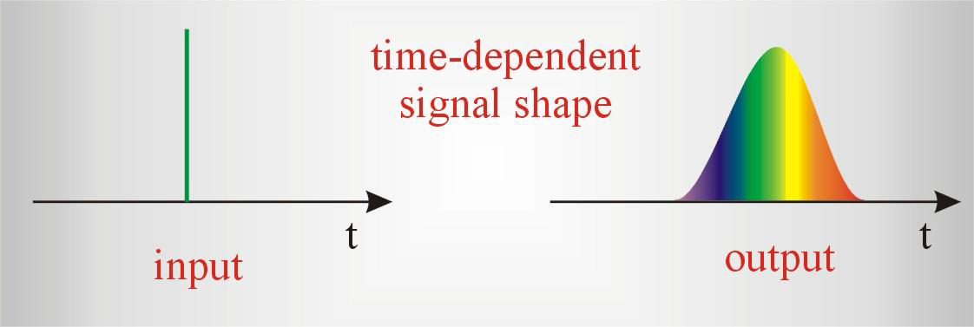
Pulse Spreading due to Dispersion
Dispersion

Slide 14
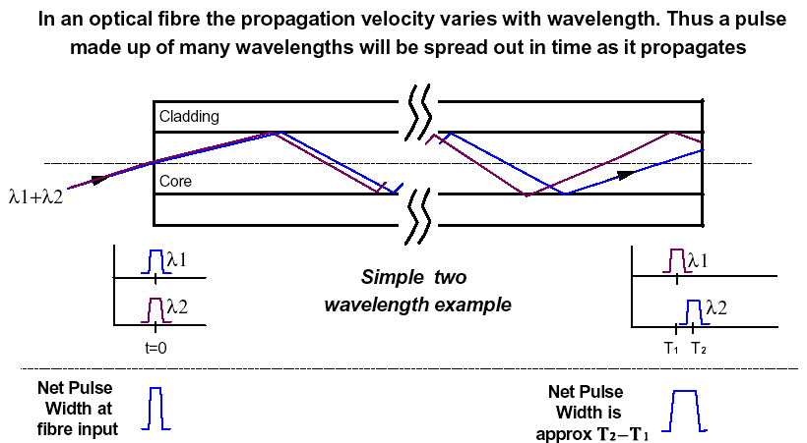
Material Dispersion

Slide 15
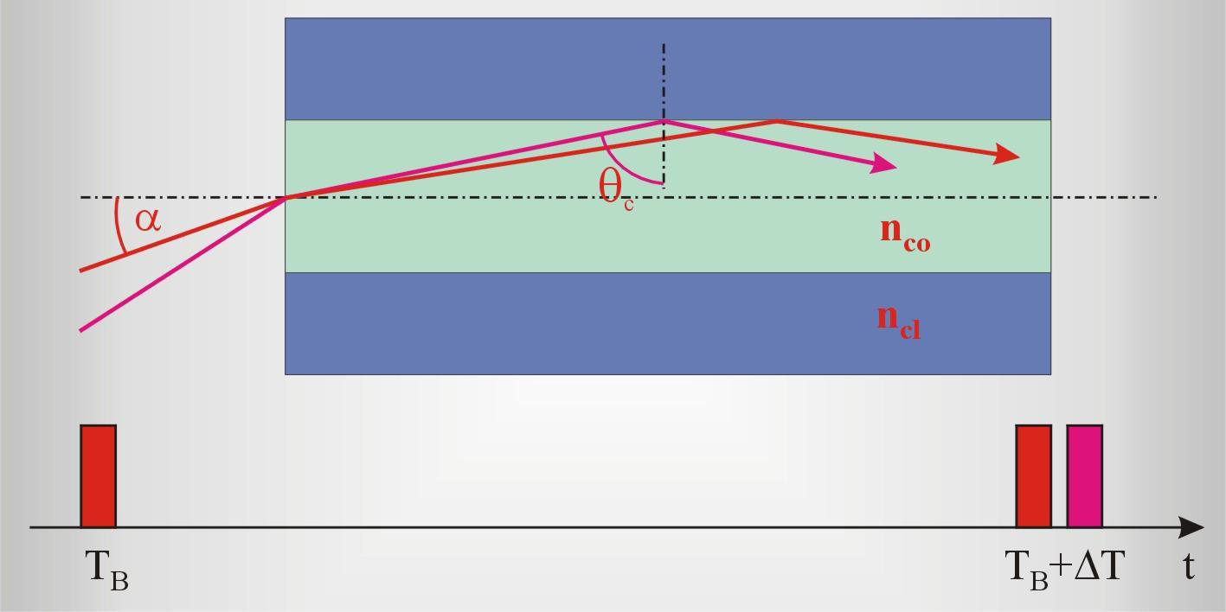
Multi-Mode Dispersion
Temporal Pulse Broadening in a step index fiber
Rays have same speed but they cover different paths and reach the detector at different time-----Pulse Broadening

